Slide 1
Hypothesis Testing
Data 101
Jason Woo

Slide 2
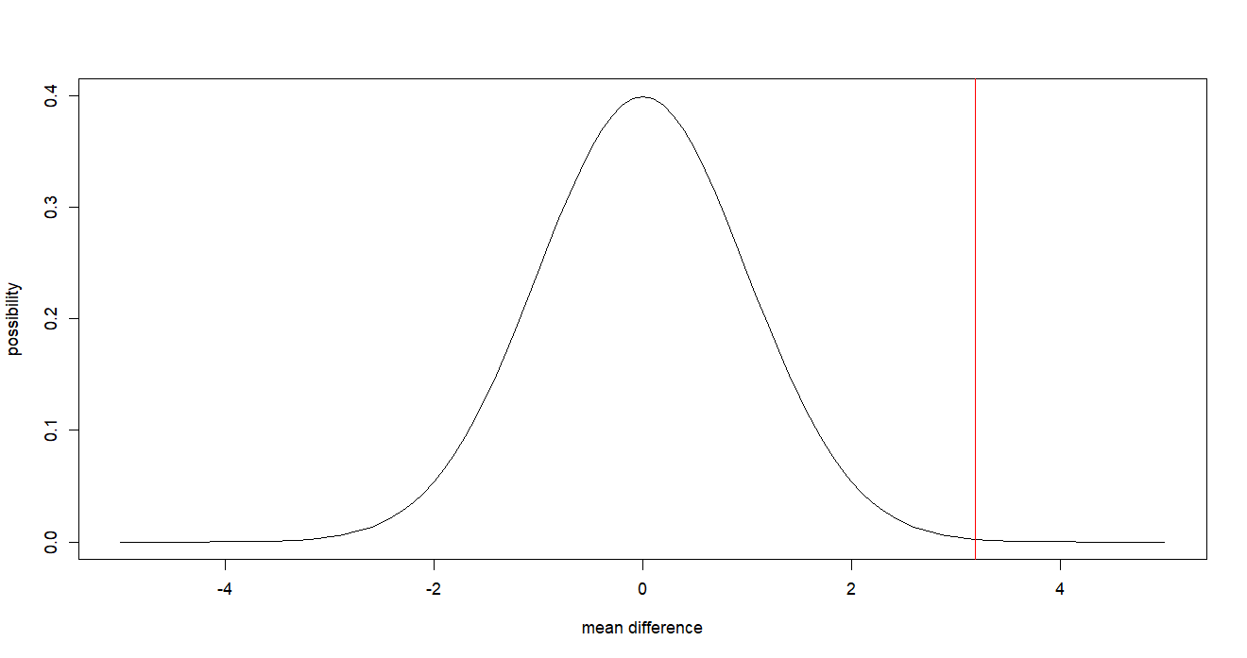
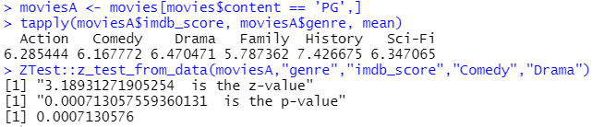
Alternative Hypothesis Part A #1
Alternative Hypothesis ->
Drama movies rated PG have a higher imdb score than Comedy movies rated PG
Since the p-value is less than 0.05 and the red line is far right, we found great support to our alternative hypothesis

Slide 3
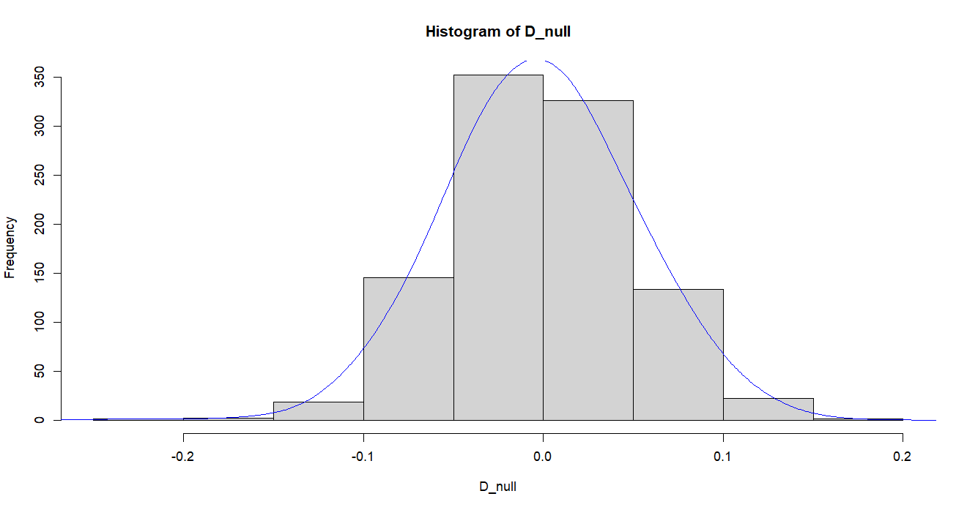
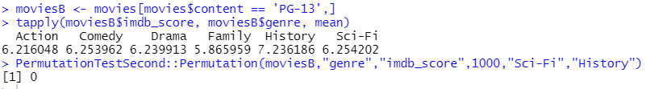
Alternative Hypothesis Part A #2
Alternative Hypothesis ->
History movies rated PG-13 have a higher imdb score than Sci - Fi movies rated PG-13
Using the permutation test, we reject the null hypothesis since the p-value is at 0
Since the p-value is at 0, which is less than 0.5, we found great support to our alternative hypothesis

Slide 4
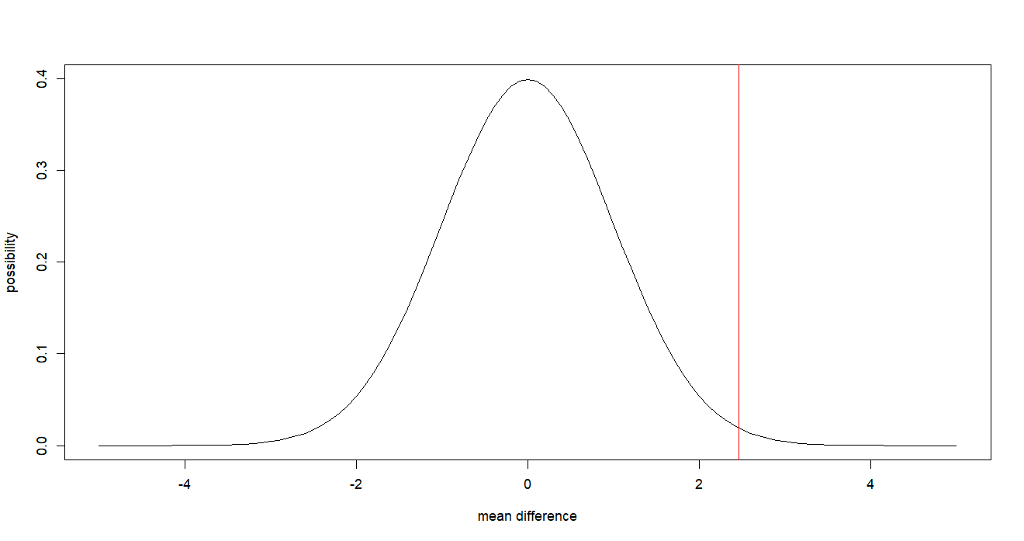
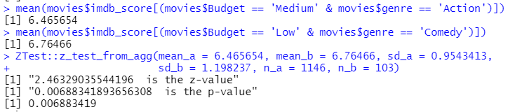
Alternative Hypothesis Part A #3
Alternative Hypothesis - >
Low Budget Comedy Movies have a higher imdb score than Medium Budget Action Movies
I used the Z test on aggregates to find sd and mean for imdb scores for movies within a certain budget and genre
The p - value ended up being close to zero and below 0.05, which means we found great support to our alternative hypothesis

Slide 5
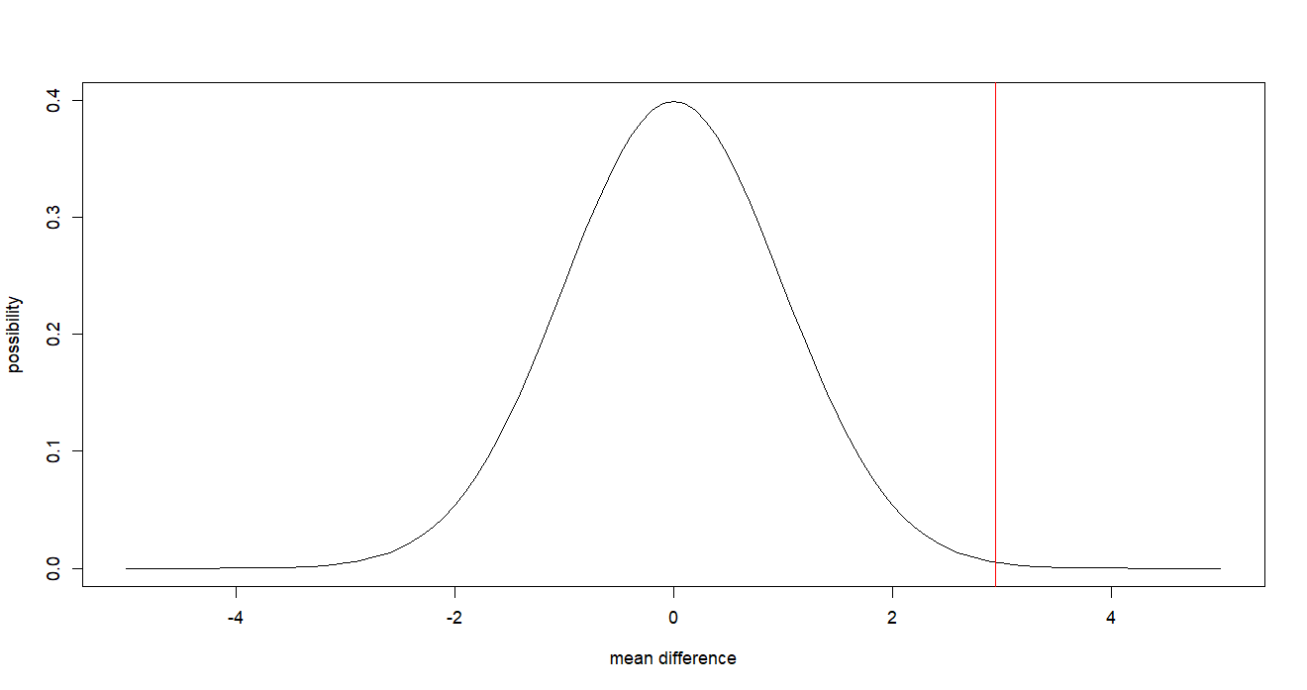
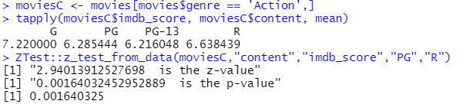
Part B #1
Null Hypothesis ->
R rated Action Movies have the same imdb score as PG rated Action Movies
Alternative Hypothesis ->
R rated Action Movies have higher average imdb score as PG rated Action Movies
We reject the null hypothesis because the p-value is below 0.05, at 0.0016 where the value is not zero but close to 0.001

Slide 6
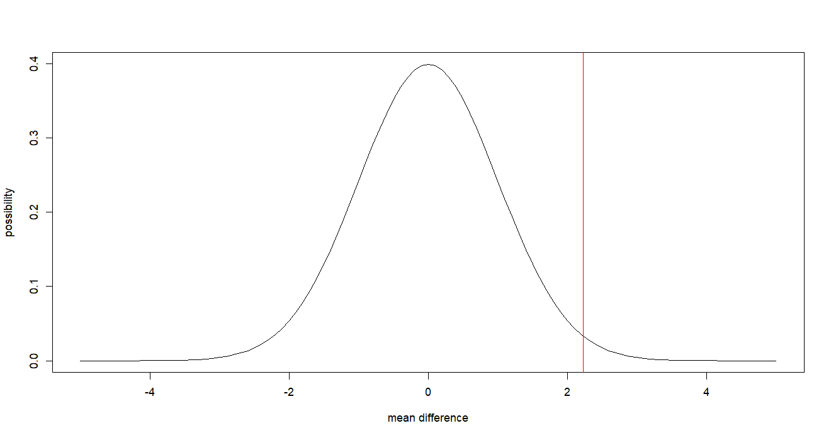
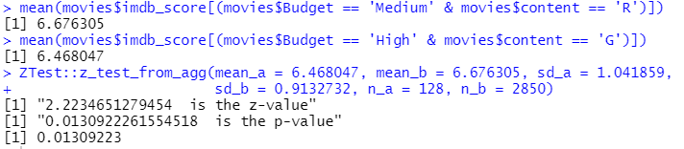
Part B #2
Null Hypothesis ->
Medium Budget R rated Movies have the same imdb score than High Budget G rated Movies
Alternative Hypothesis ->
Medium Budget R rated Movies have higher average imdb score than High Budget G rated Movies
We reject the null hypothesis since the p-value is 0.013, which is close, but lower than the example critical value of 0.03

Slide 7
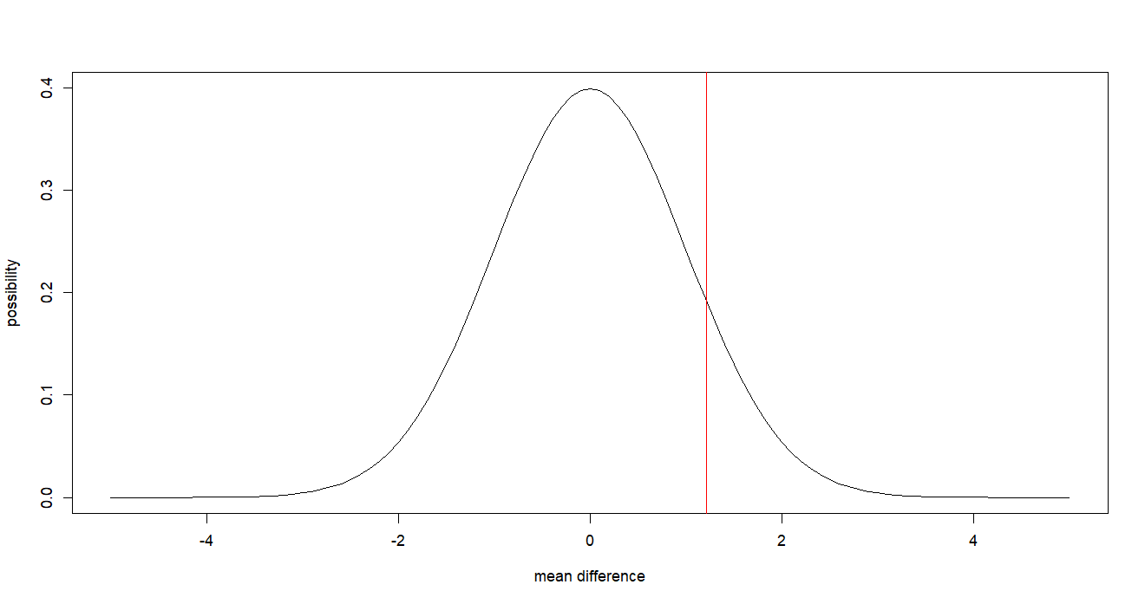
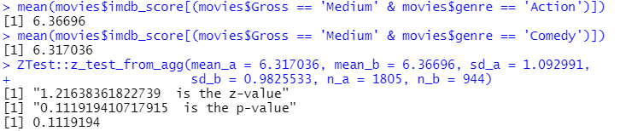
Part B #3
Null Hypothesis - >
Medium Gross Action Movies have the same imdb score as Medium Gross Comedy Movies
Alternate Hypothesis - >
Medium Gross Action Movies have higher average imdb score than Medium Cross Comedy Movies
We do not reject the null hypothesis since the p-value from the z test from aggregates is above 0.05, at 0.112

